Slide 1

Medical Test Recommender!
By-Chinmay Tiwari
Section-D (IIIrd Year/ VIth Sem)
Roll No.-04
University Roll No.-1918306

Slide 2
Phases Of The Presentation:
Why I have chosen this project?
How will the project work?
Video Demonstration of the Project
Problems Faced while developing the Project
Future Scope

Slide 3
Why I have chosen this project?
The purpose of choosing this project was that I found this topic very interesting and thought that this project can help many.

Slide 4
How will the project work?
This project will ask the user to give appropriate answer to it’s questions and on the basis of those answers it will recommend which disease they may have and what test should they go for.

Slide 5
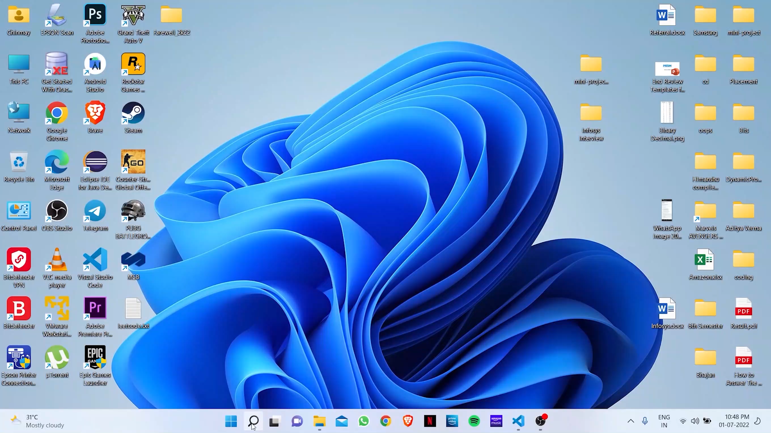
Video Demonstration:

Slide 6
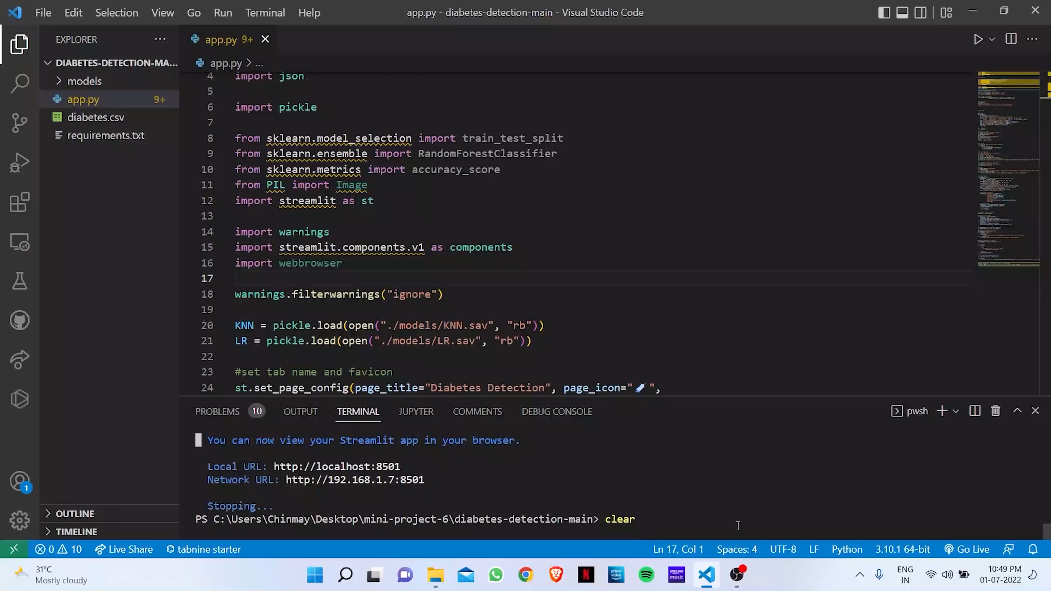
Video Demonstration:

Slide 7
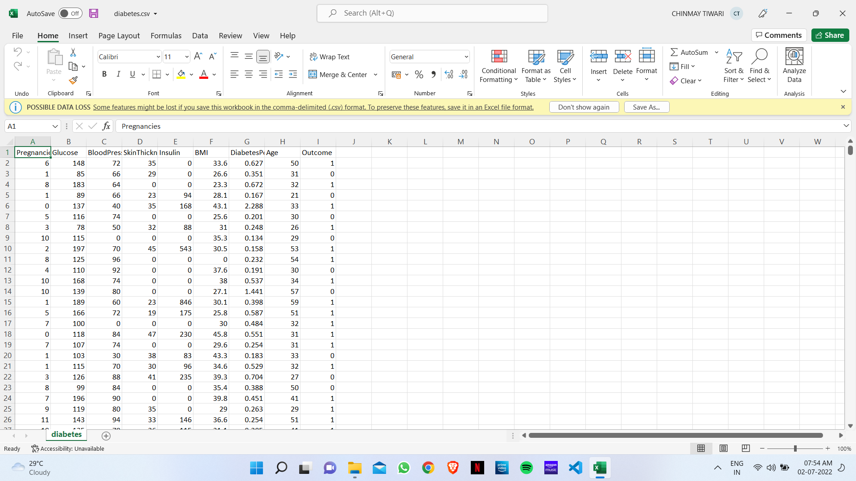
ScreenShot Of The Dataset Used For Diabetes Prediction:

Slide 8
Problems Faced:
No dataset available
No latest research paper available, one was available which was published in 2006 which is now more that 15 years old and that to publishers have not allowed to view by not accepting the view-request.
No proper guidance (resources not available)

Slide 9
Future Scope:
This project does not have any much future presence, because if we develop a recommender system then also we have to visit the doctor for the prescription for the test and without proper examination doctor will not write any test and no test(which is severe in terms like-endoscopy, MRI, CT-Scan, etc.) can be done without a proper prescription.

Slide 10


Thank You!

